Slide 1
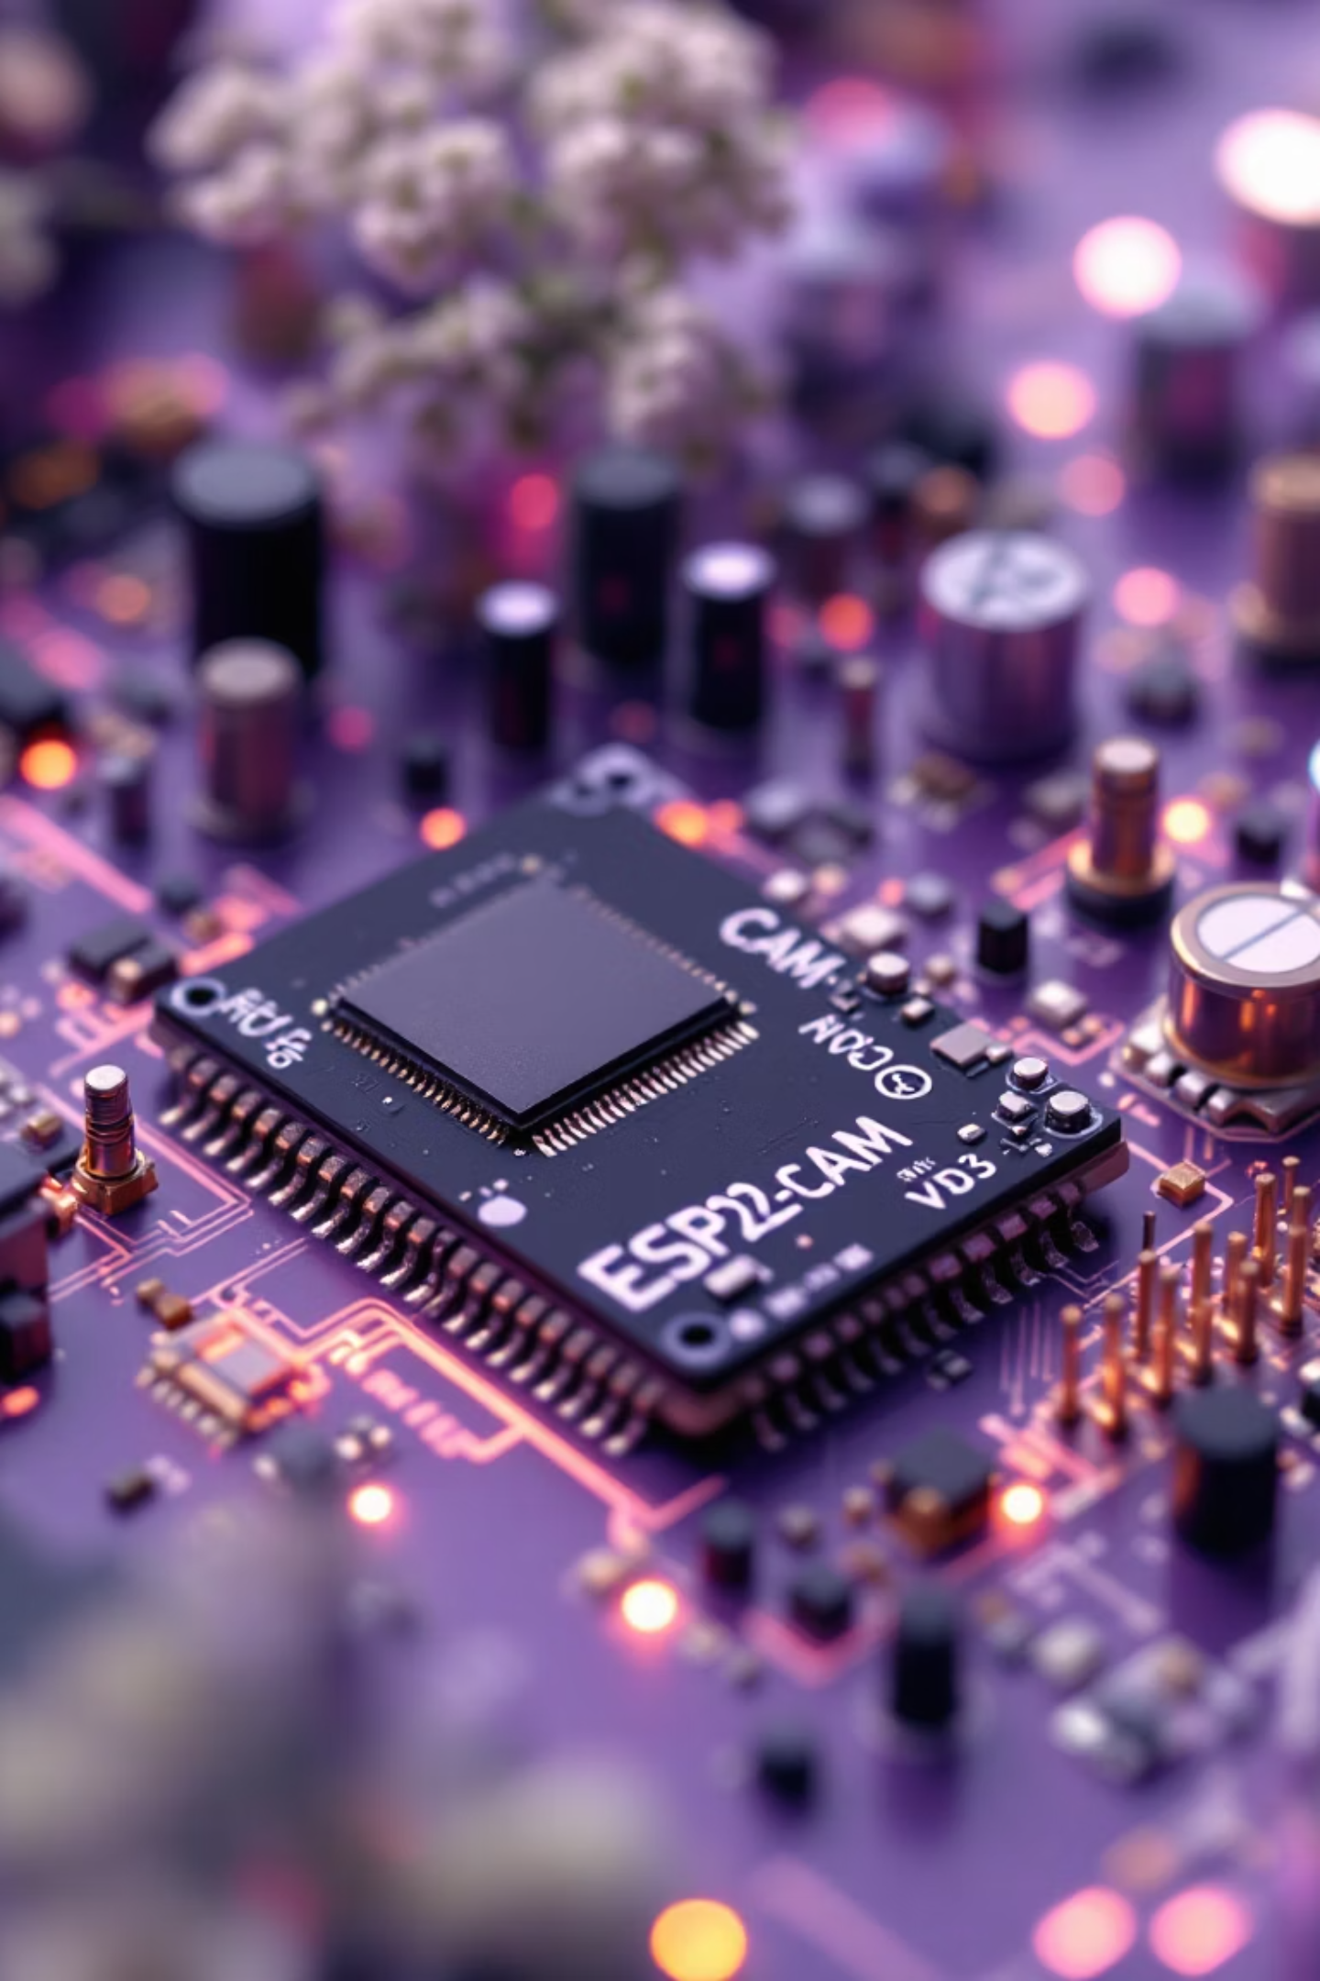
VisionEdge: Compact AI Object Detection System Using ESP32-CAM and OpenCV
Revolutionising surveillance with intelligent edge computing technology
N.VENKAT-323129512037

Slide 2
The Challenge with Traditional Surveillance
Passive Monitoring
Manual Analysis
Limited Intelligence
Traditional CCTV systems provide only basic recording capabilities without intelligent analysis or real-time insights.
Video review requires human operators, making it slow, error-prone, and inefficient for detecting critical events.
Existing systems lack AI-powered recognition, missing opportunities for automated alerts and smart monitoring.
VisionEdge addresses these limitations by integrating AI-powered object recognition directly on ESP32-CAM hardware, enabling affordable and efficient real-time monitoring.

Slide 3
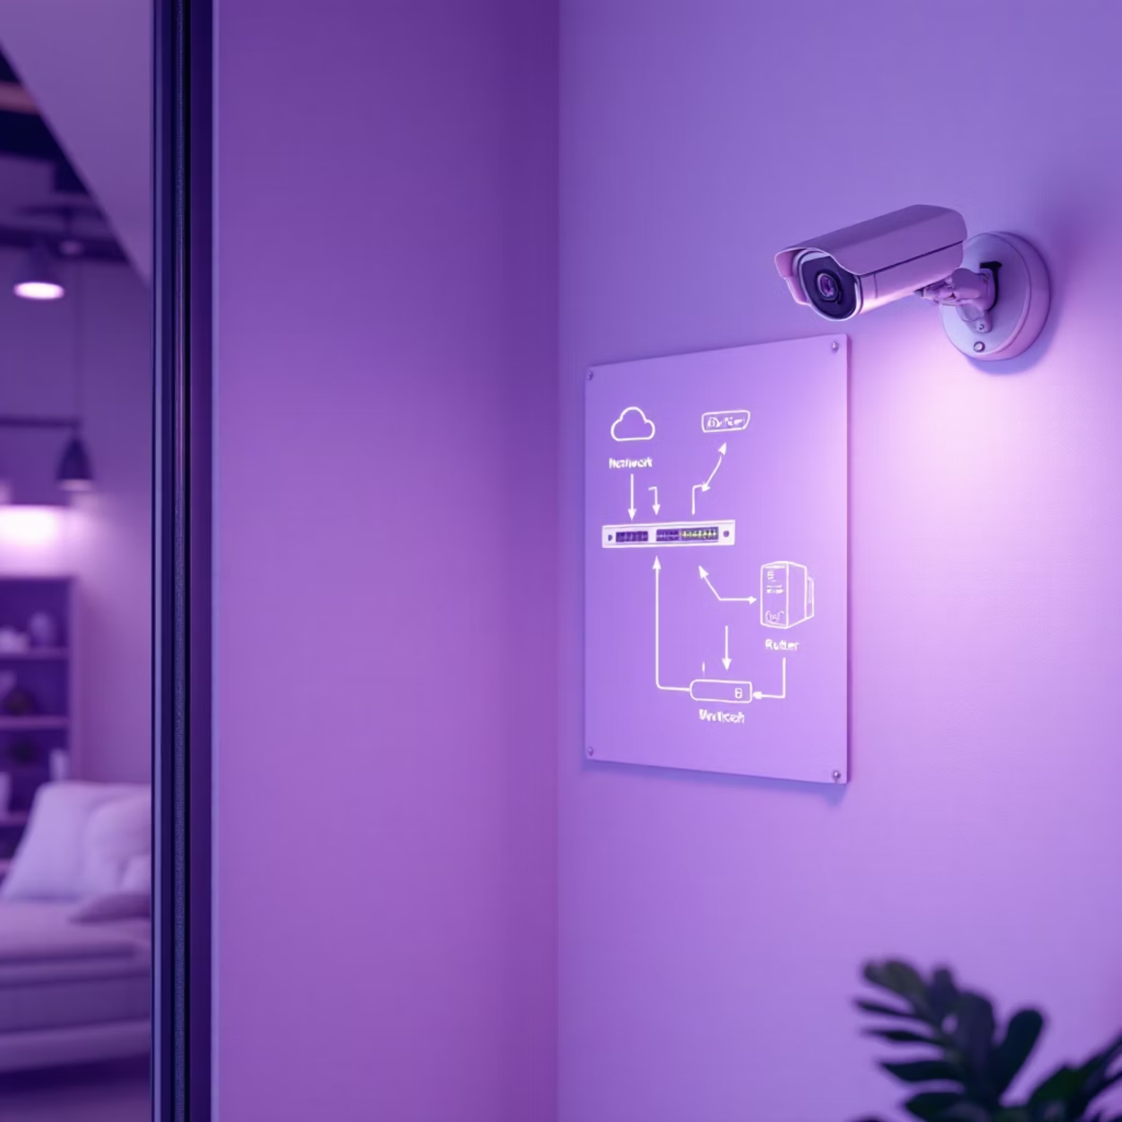



Market Need Analysis
Traditional CCTV Limitations
High latency due to centralised server processing
Increased bandwidth consumption for video streaming
Expensive deployment and maintenance costs
Complex infrastructure requirements
Real-time Detection
Cost-Effective Operation
Edge Deployment
Instant object identification without server delays
Low-cost hardware with minimal power consumption
Easy setup for homeowners and small businesses

Slide 4
System Requirements
Functional Requirements
Non-Functional Requirements
Video Streaming
Cost Efficiency
Real-time video capture and transmission via ESP32-CAM with stable Wi-Fi connectivity
Affordable hardware components suitable for budget-conscious users
Object Detection
Power Optimisation
Accurate identification of people, vehicles, and animals using pre-trained AI models
Low power consumption enabling battery-powered operation
Alert System
Performance
Automated notification generation and comprehensive logging capabilities
Efficient detection algorithms maintaining good frame rates
Scalability
Web Interface
Support for multiple cameras and expandable object classes
User-friendly monitoring dashboard with configuration options

Slide 5
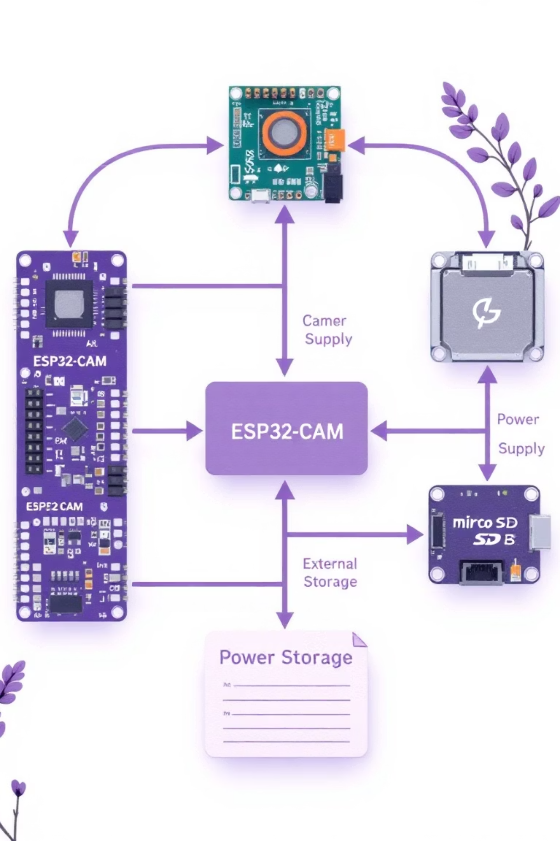



Solution Architecture
ESP32-CAM Module
Captures high-quality video and streams data via Wi-Fi connection to processing unit
Python + OpenCV Processing
Performs real-time object detection using advanced computer vision algorithms
Flask Web Interface
Provides intuitive monitoring dashboard with live video feed and detection results
The modular design separates concerns: hardware handles image acquisition, software processes detection, and the web interface manages user interactions.

Slide 6
Implementation Roadmap
Phase 1: Hardware Setup
1
Configure ESP32-CAM module with Wi-Fi streaming capabilities and test video transmission quality
2
Phase 2: AI Detection
Develop Python application with YOLOv3 and OpenCV for accurate real-time object detection
Phase 3: Web Interface
3
Build Flask-based dashboard with live video streaming and detection result visualisation
4
Phase 4: Integration Testing
Conduct comprehensive end-to-end testing to validate system performance and reliability
Phase 5: Documentation
5
Create detailed documentation and user guides for easy deployment and maintenance

Slide 7
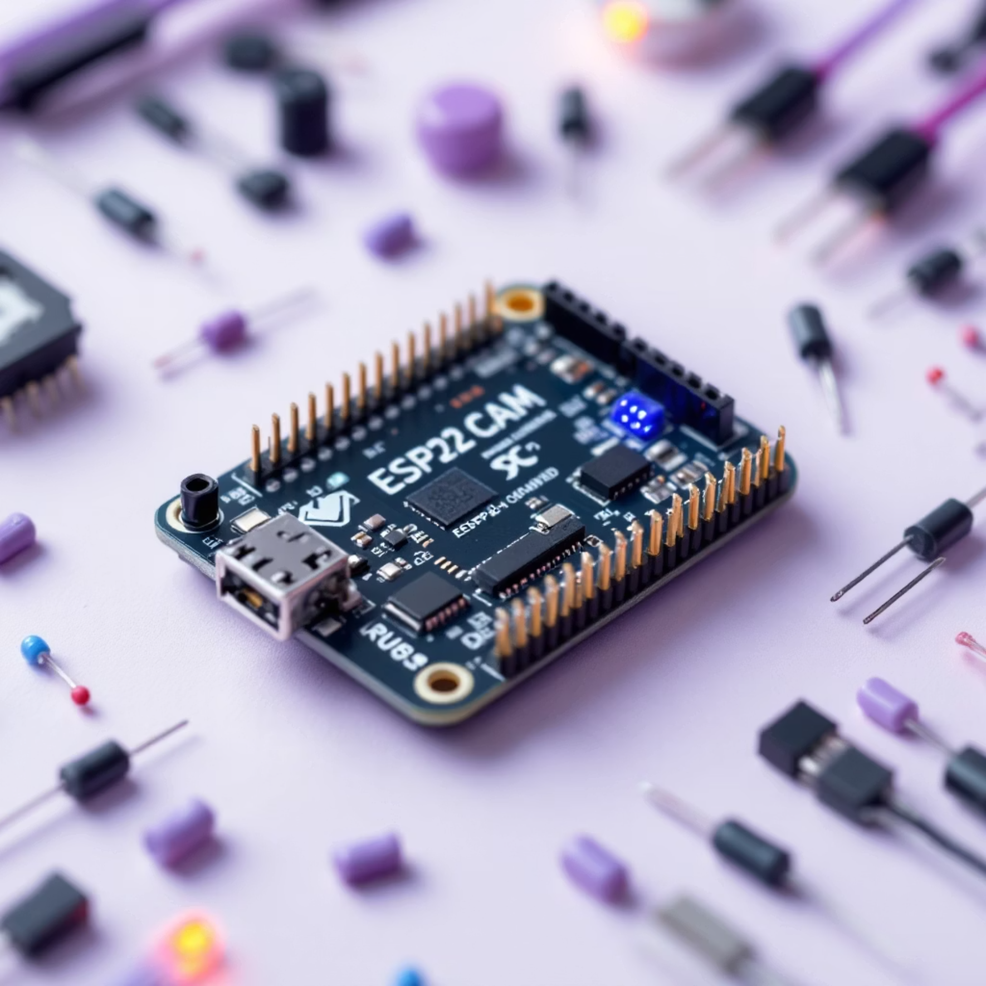





Technology Stack
ESP32-CAM
Powerful microcontroller with integrated camera module and Wi-Fi connectivity
Python
Primary programming language for AI processing and system logic
OpenCV
Advanced computer vision library for image processing and object detection
Flask
Lightweight web framework for creating responsive monitoring interface
YOLOv3
Pre-trained deep learning model for accurate real-time object detection

Slide 8




System Implementation
Web Application
Detection Engine
Flask interface provides live video monitoring, detection history logs, and real-time connection status
ESP32-CAM Firmware
Python application captures frames, processes them through OpenCV, and generates bounding boxes with confidence scores
Custom firmware enables reliable Wi-Fi streaming with optimised video quality and minimal latency

Slide 9
Testing & Validation Results
Unit Testing
Integration Testing
ESP32-CAM video streaming verified with stable transmission
Complete end-to-end detection pipeline validated with comprehensive scenario testing
Object detection algorithm accuracy thoroughly tested
Web interface responsiveness confirmed across devices
20
<100ms
<200MB
2Mbps
FPS
Latency
Memory
Bandwidth
Average frame rate achieved
Detection processing time per frame
System memory usage
Video streaming requirement

Slide 10




Project Impact & Future Directions
Performance Achievements
85%
Overall Accuracy
Reliable object detection performance
99.5%
System Uptime
Exceptional reliability during testing
10x
Cost Savings
Cheaper than traditional CCTV systems
VisionEdge successfully demonstrates the feasibility of low-cost, AI-powered edge surveillance, providing real-time intelligence while meeting all requirements for affordability, scalability, and reliability.
Future Enhancements
Enhanced detection accuracy through model fine-tuning and advanced algorithms
Expanded object classification including custom categories for specific use cases
Improved web interface with advanced analytics and mobile application support

